Slide 1
2018 Cybersecurity
Final Project

Slide 2
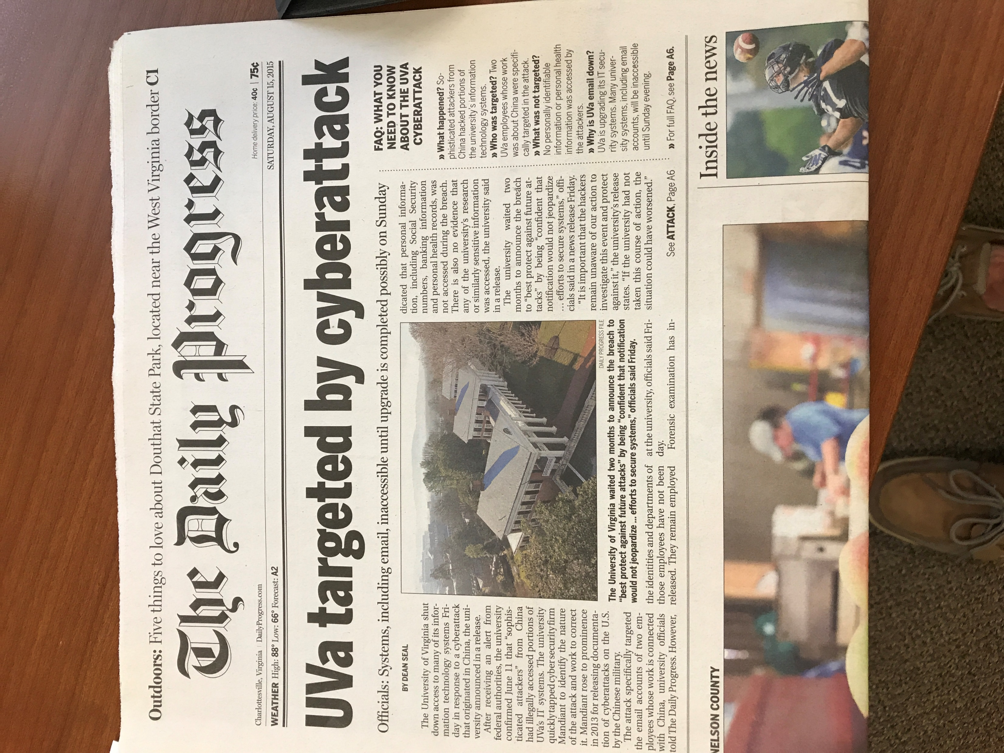
Aug. 15, 2015

Slide 3
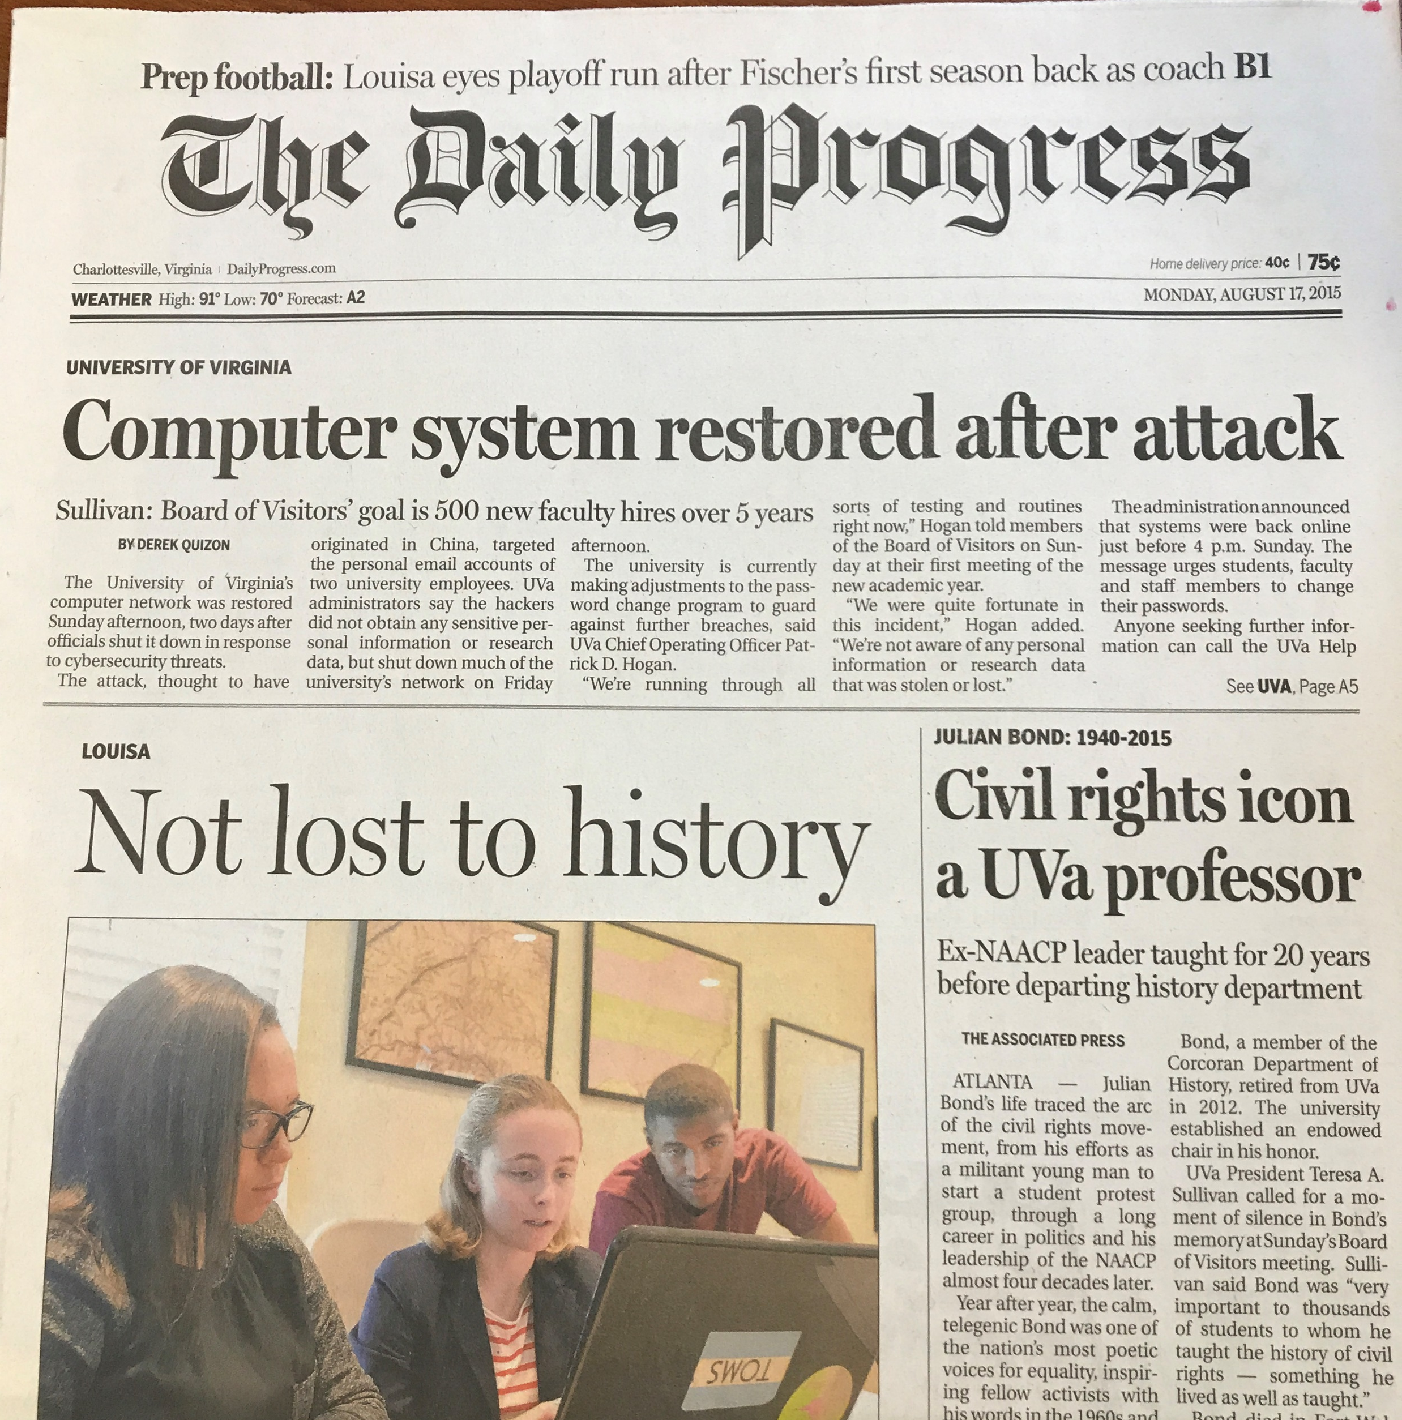
Aug. 17, 2015

Slide 4
Back Story
Your team has been hired by UVa Finance
Needs:
Executive Summary
Threat Assessment
Risk Assessment
Incident Response Plan
Analysis of Phishing Simulation (Data Provided)
Security Training Program for Staff
Notes:
w/Master - KK

Slide 5
Security Benchmark was undertaken by Gartner Consulting

Slide 6
Deliverable
Written Report
5 minute video -> Summary of the Report
Peer Evaluation

Slide 7
Where the Project starts….
Project Phoenix ended with:
Determine the extent of the intrusion
Develop a remediation plan
Execute the remediation plan
Harden UVA’s defenses
Restore services

Slide 8
Project Document
Notes:
w/Master - KK

Slide 9
Executive Summary
Principle Points
Contains
Purpose
Scope
Methods
Results
Conclusions / Recommendations
See Executive Reports Document on Blackboard
Notes:
w/Master - KK

Slide 10
Threat Assessment
You will examine the current landscape of threats
Report on the attacks UVa finance should be worried about
Some resources:
Verizon RISK Report 2018
IBM Security Report
McKinsey / Forrester
www.cyentia.com/library/
Etc…
Notes:
w/Master - KK

Slide 11
Risk Assessment
What are the top risks for UVa Finance
Focus on impact to services
Need to do a analysis of the services offered
Then look at risks to those services
Resources:
Risk Registry
Risk Frameworks from class
Etc…
Notes:
w/Master - KK

Slide 12
Incident Response Plan
Develop a Basic Incident Response
Focus on the 10 steps for an incident response plan
Resources:
Course material
www.cisecurity.org/controls/
Etc…
Notes:
w/Master - KK

Slide 13
Phishing Data (Nov 16)
Collected Nov. 2016
UVa Finance is Business Unit #1
Other units collected
What does this data mean?
Notes:
w/Master - KK

Slide 14


Slide 15
Design a Training Program
About 200 employees
3 IT Support People
All in a Single Building
Between new to 27 years tenure
Between 23 – 68 years old
Variety of technical skills

Slide 16
Report and Video Due: Dec 12th at 11:59am

